Slide 1


Team Name: Innovation Catalyst
Team Leader name: Razia Patel
Team Member(s) : Razia Patel
Team Name :
Team Leader Name:
Team Members: (Count & Names)

Slide 2



Brief Summary of Project
THEME 2 : Data Analytics Dashboard
Problem Statement-
Develop a web-based platform for XYZ Bank to host Advanced Analytics and Tax Assessment Features for its retail customers
Objectives:
- Investment Dashboard: Insights & Tax Info
- Popular Investments: Top mutual funds, FDs, stocks
- High-Return Investments
- Identify Rich Investors
- Historical Returns for Top 5 Customers
- Tax Assessment for Informed Wealth Management
-

Slide 3
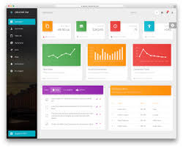
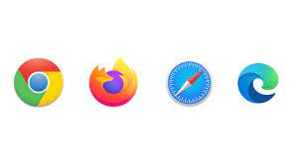
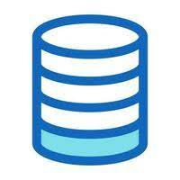



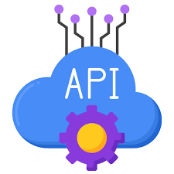
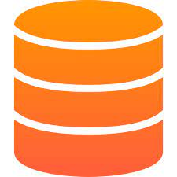
High level design diagram
Server
Generative-AI
Client
Web APP
Presentation layer
Chabot(LLM)
HTTP Request
Back END
HTML Response
Business Logic
Web scrapper
Data Layer
Vector database
ETL
Excel files)
Data via YAHOO Finance API
Database

Slide 4
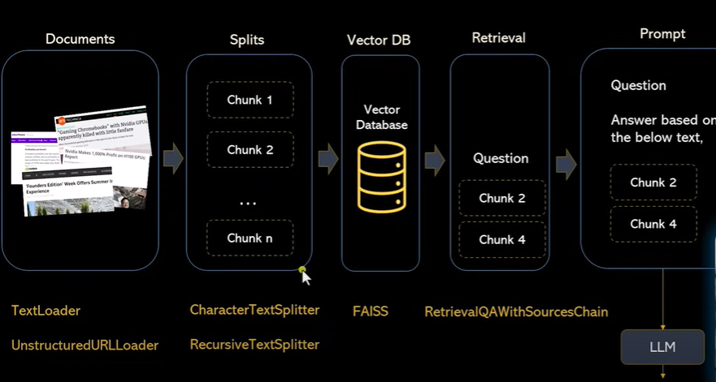
Financial Chabot
Detailed Design Diagram
Technology
Beautiful Soup
LangChain Framework
LLM (OpenAI / PaLM)

Slide 5
Technology Stack
Django or Flask (Back-End Framework): Choice between Django or Flask to build the back-end of this application based on below considerations
Flask: For a lightweight, modular back-end with flexibility.
Django: For a feature-rich, full-stack framework with built-in features.
Python: For developing server-side logic and data processing
.
Database: Relational Database: Use of database MySQL for structured financial data and customer data
AngularJS (Front-End Framework): AngularJS to create dynamic and interactive user interfaces
Incorporating a chatbot into front-end analytics: can provide an intriguing contextual layer to current reporting, enhancing the overall data insights and complementing the existing visualizations.(Langchain ,openAI,custom data)
Web Development:
HTML/CSS: For structuring and styling the web pages.
Bootstrap: A CSS framework for responsive design.
JavaScript: For enhancing user interactions and user experience.
Data Visualization:
Charting Libraries: Seaborn , Plotly for charting and graph creation.
Front-End (User Interface)/web development
+ Generative AI (Chatbot )
Back-End (Server-Side)/Database
Data Analysis ,Feature engineering ,clustering and ETL (Extract, Transform, Load):
ETL :
Extract:/transform Python –pandas, numpy libraries to extract data clean, aggregate, and transform data. from various sources, such as databases, external APIs, or excel files.
Load::After data transformation, the processed data will be loaded into chosen databases (Mysql). Use of libraries like SQLAlchemy (for Flask) or Django ORM (for Django) to interact with the database and store the transformed data.
ETL Workflow: ETL workflow will be created within the Flask or Django application by defining specific endpoints or modules dedicated to ETL processes
Schedule ETL Jobs: To automate ETL processes and schedule data updates, task scheduler or cron jobs will be considered for this purpose. Popular libraries for scheduling tasks include: Celery: A distributed task queue that can be used with Flask or Django to run ETL jobs at specified intervals.
Python libraries:
Python libraries like Pandas, NumPy , and Scikit-Learn ,scipy for data manipulation, analysis, clustering analysis and ETL processes. These will be integrated within the Django or Flask application to handle data processing tasks.
ETL Tools/Components
Cloud Services(Scalability-optional )
Cloud Services(Scalability-optional )
AWS- Use of cloud computing services for hosting, scaling, and ensuring data security.

Slide 6

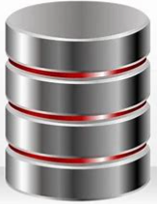

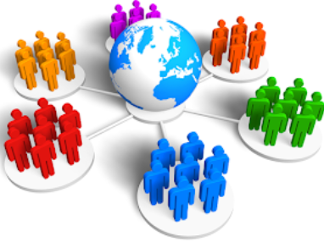



Solution approach
Problem Definition
Data Cleansing & EDA
Data Sources
Missing Value Treatment
Univariate Analysis
Bivariate Analysis
Outlier Check & Treatment (if applicable)
Ensuring consistency and eliminating duplications
create Investment Dashboard with Insights & Tax Info
Data Set - Theme 2
Yahoo Finance API
Clustering
Data Storage/Data Warehousing
Choose Warehouse: Select Redshift or on- prem solution.
Data Security: Encrypt & Control Access.
ETL Process: Automate Extraction, Transformation, Loading
Feature Engineering /
Transformation
Development/Testing/ Deployment
Closing
Manipulation and preparation of data for analysis, reporting
Python dashboard (Dash/ Plotly /Flask)
Testing
Local deployment for prototype demonstration. Global deployment for Customer
Final presentation to Stakeholders

Slide 7
Assumptions
Investment choices considered - mutual funds, fixed deposits (FDs), and stocks. Filtered level –Active /Closed /Both
Customer Preferences: will be based on investment type (mutual funds, FDs, stocks).
Latest data for stocks will be accessed using API (via freely available financial data providers)
Assumptions to simplify performance metrics will be considered for each investment type .
Tax calculations - Gains from mutual funds / Stocks -15% (1 year) or 10% (> Rs.1L) and Gains from FD taxed at 10%.

Slide 8
FUTURE ENHANCMENTS
AI-Innovative - AI-powered features to make the financial dashboard more insightful, user-friendly, and responsive to individual needs.
Personalized Recommendations: use of collaborative filtering to recommend investments based on a customer's historical preferences and behavior.
ENHANCE
Additional Data/columns :
Credit Scores: Credit score information can be valuable for assessing a customer's creditworthiness and financial health.
Employment and Income: Employment information, including the name of the employer, job title, and income. Total annual income or salary.
Family and Dependents: Information about family members or dependents can be valuable for financial planning and offering family-centric services.
Demographics: Other demographic data, such as marital status, education level, and occupation.
Preferences and Risk Tolerance: Customer preferences for investment styles (e.g., conservative, aggressive)
and risk tolerance levels.
USER PIC-PROFILE PIC
INNOVATE
Sentiment Analysis: Employ natural language processing (NLP) techniques to analyze news and social media sentiment, providing insights into market trends.
Natural Language Processing (NLP): Utilize NLP algorithms to extract insights from unstructured data sources, such as user-generated text or social media comments. This can help in understanding user sentiment and feedback.
Automation of Queries: Implement natural language query processing or chatbots to allow users to interact with the dashboard using plain language. AI-powered chatbots can interpret user queries and retrieve relevant data and visualizations.
Personalization: Use AI to personalize the dashboard for individual users or user segments. Machine learning algorithms can tailor the content and recommendations based on user behavior and preferences.
Real-time Data Updates: Implement AI tools for real-time data processing and updates. AI can continuously monitor data sources and trigger alerts or updates when significant changes occur.
Automation of Reports: Automatically generate and distribute reports based on predefined criteria. AI can identify when specific conditions are met and trigger the report generation and distribution process.
Natural Language Generation (NLG): Use NLG tools to automatically create human-readable narratives that explain data insights and trends, making the dashboard more user-friendly.
User Feedback Analysis: Analyze user feedback and interactions with the dashboard using AI sentiment analysis and user behavior modeling to improve the system continuously.
User-Generated Content:
User Feedback Data:
Query and Interaction Data:
News and Social Media Data:

Slide 9

Brief snippet of team
- Razia patel
11 years of experience in the Information technology sector and a comprehensive understanding of various web based technologies.
My track record is a testament to my ability to design and implement intricate solutions, consistently delivering tangible, data-driven results. My experience extends to crafting solutions that address specific business challenges and collaborating closely with clients and internal teams to ensure success.
I have keen interest in the AI , Data Science, python development, and NLP based applications.
My educational background in computer engineering provides a solid underpinning for tackling even the most intricate challenges.

Slide 10
Thank You for this opportunity !!!
Name : Razia Patel
Email ID : razia.pateldo@gmail.com
Linked In : https://www.linkedin.com/in/razia-patel-59bb69201/
Git hub : https://github.com/iamraziapatel

